Slide 1
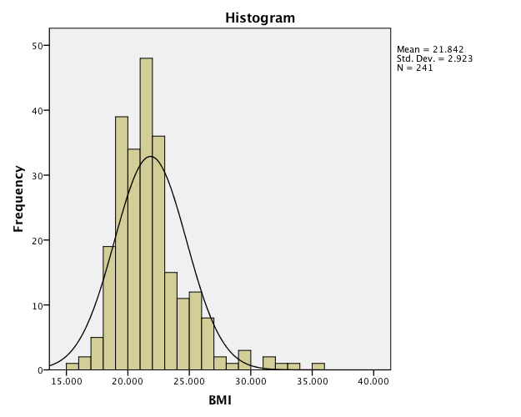
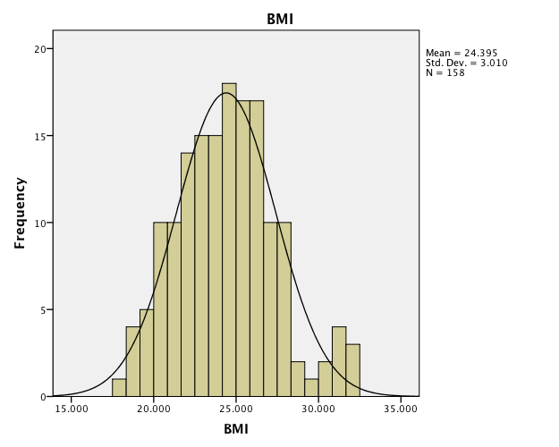
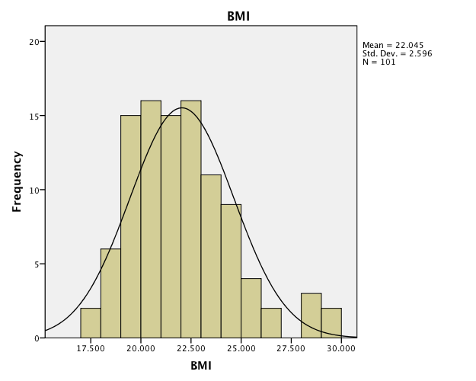
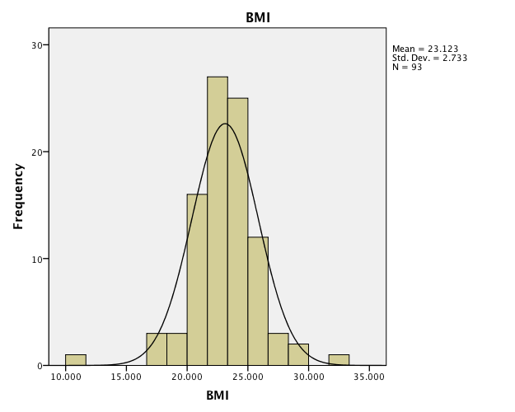
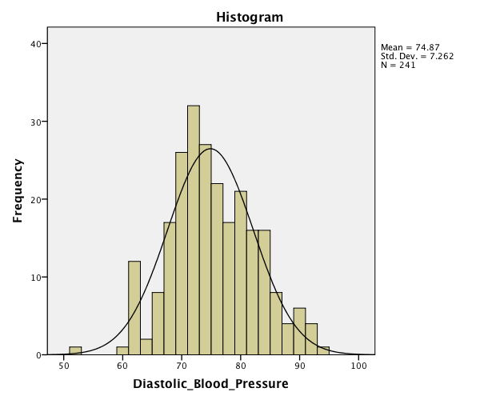
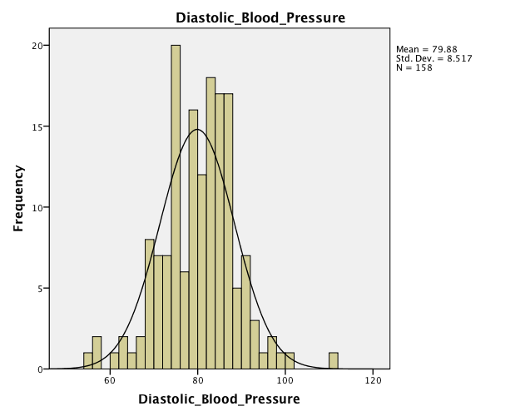
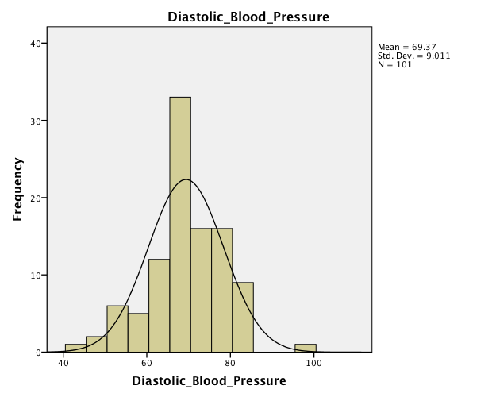
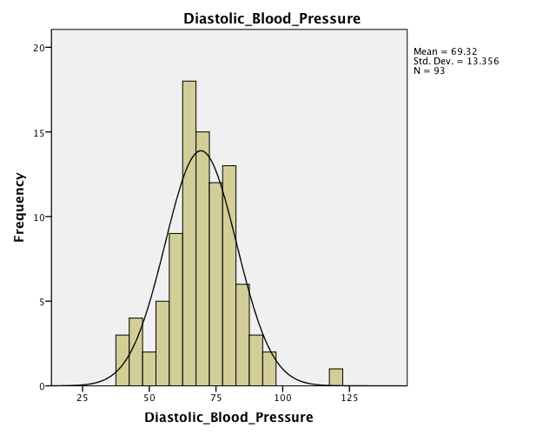
Cardiovascular Health of Young Adults: A Comparative Study
Gina Fitzgerald, Gabriella Smith, & Dr. Don Thompson
Division of Natural Science; Pepperdine University
Results
Abstract
Cardiovascular disease for some time has been the leading cause of death in the Western world. Primary prevention is the only way to halt the onset of cardiovascular disease, yet there is little information on the prevalence of risk factors for cardiovascular disease in young adults. This study seeks to evaluate students from the Catholic University of Argentina and Pepperdine University of America for the prevalence of CVD risk factors (diet, exercise, parental health history), as well as knowledge of CVD and daily habits that contribute to heart health. Thus we compared two cultures with very different lifestyles and prevalence of risk factors. We hypothesized that students with low prevalence of CVD risk factors are more likely to maintain a normal range of blood pressure and heart rate, and those with high prevalence of CVD risk factors are more likely to have heart rate and blood pressure outside an acceptable range. A web-based survey assessed 500 students from Buenos Aires, and 500 students from Malibu in the areas of current medical information, personal health history, family health history, personal habits, and knowledge of cardiovascular health. Additionally, blood pressure, heart rate, and demographic information were recorded. Our research supports our hypothesis: students with greater CVD risk factors displayed increased risk of heart rate and blood pressure outside a healthy range.
Methods
A survey assessed 500 students from Buenos Aires, and 500 students from Malibu in the areas of
Current medical information
Personal health history
Family health history
Personal habits
Demographic information
Knowledge of cardiovascular health.
Additionally, blood pressure, heart rate were recorded.
International students, and those outside the 18-25 age range were omitted from final analysis
Argentina
Total Sample Size = 399
Female Sample Size = 241
Average Age = 20.47
Male Sample Size = 158
Average Age = 20.87
USA
Total Sample Size = 195
Female Sample Size = 101
Average Age = 19.95
Male Sample Size = 94
Average Age = 19.82
A
C
E
G
Introduction
When researching cardiovascular disease we found little literature sources on the prevalence and risk factors in young adults. As college students, this subject is important in our own lives and the lives of our peers. According to a study in the Official Journal of the American Academy of Pediatrics, cardiovascular disease is the leading cause of death among adults in the US. In addition, the risk factors for various cardiovascular diseases preexist in childhood and young adults. According to another study by the Journal of American Medical Association, cardiovascular disease is also the leading cause of death among the US Hispanic and Latino population. Often times, the prevalence of CVD and CVD risk factors in Latino individuals are attributed to the lower socioeconomic status held by many of these individuals, especially in the US. While studying abroad in Argentina, a cross-cultural comparative study was proposed that would evaluate CVD in young adults in both the United States and Argentina. We aimed our focus more on if and how the individuals’ personal habits and health histories affect the prevalence of CVD and CVD risk factors in these two populations, keeping socioeconomic status, age, and nationality constant.
B
D
F
H
A-B: Argentine Females C-D: Argentine Males E-F: US Females G-H: US Males
Significant Health Differences: Argentine v US Females
Significant Health Differences: Argentine v US Males
Significantly Different Mean Scores – p-value < 5%
Diastolic BP
Asthma
High Cholesterol
Diabetes
Parent Health History (Diabetes, Coronary Disease, Stroke, Heart Failure)
Smoker
Unhealthy Diet (Daily Soda, Fast Food, Low Fruit & Vegetable Consumption)
Alcohol Consumption
Sleep
Significantly Different Mean Scores – p-value < 5%
BMI
Systolic BP
Diastolic BP
Asthma
High Cholesterol
Diabetes
Parent Health History (Diabetes, Coronary Disease, Stroke, Heart Failure)
Smoker
Unhealthy Diet (Daily Soda)
Regular Exercise
Alcohol Consumption
Sleep
Acknowledgments
Thank you to the Pepperdine Natural Science Department, Dr. Rafael De Sanzo; Pepperdine Buenos Aires Program, and to all student participants
References
May AL, Kuklina EV, Yoon PW. Prevalence of cardiovascular disease risk factors among US adolescents, 1999-2008. Pediatrics. 2012;129(6):1035-1041
Daviglus ML, Talavera GA, Avilés-Santa ML, et al. Prevalence of major cardiovascular risk factors and cardiovascular diseases among Hispanic/Latino individuals of diverse backgrounds in the United States. JAMA. 2012;308(17):joc1201051775-1784
Discussion
T-tests determined which data values were significantly different between US and Argentine populations. We compared the genders of each country and found each group had unique factors that were significantly different from each other. Between the females of Argentina and the United States, parent health history and health habits, smoking, alcohol consumption, sleep and an unhealthy diet (drinking soda daily, consuming fast food and a low fruit and vegetable consumption), Diastolic blood pressure, having asthma, high cholesterol and diabetes showed significant difference between populations. Argentine and US males had similar variables that were significantly different along with BMI, systolic blood pressure unhealthy diet (drinking soda daily) and exercising regularly. Primary indicators of cardiovascular disease are BMI, systolic blood pressure and diastolic blood pressure. We ran multiple regression tests to analyze the predictors for each of these selected CVD indicators. Our data shows among Argentine females, consuming diet soda daily, smoking, drinking more than two alcoholic drinks per day and having a diabetic parent are correlated with an Argentine female’s BMI. Consuming alcohol more than once a week and having a parent with history of heart failure and stroke were predictors for systolic blood pressure. Parents with heart failure, high cholesterol and stroke predict diastolic blood pressure. Among Argentine males, BMI is predicted by drinking soda daily, consuming 5 or more alcoholic drinks, eating two daily servings of fruits and vegetables, parents having diabetes, heart failure and illness of lower limb arteries. Their systolic blood pressure is correlated with their average daily amount of sleep and history of diabetes in a parent. Smoking, consuming diet soda daily and 5 or more alcoholic in a week, the frequency of eating delivery food and history of diabetes in a parent are all predictors of diastolic blood pressure. BMI predictors for females in the US include smoking, consuming five or more alcoholic drinks in a week, exercising daily and drinking two or more alcoholic drinks in a day. According to the data of USA males, consuming two or more alcoholic drinks in a day is a predictor for BMI. Drinking diet soda daily, exercising daily and drinking two or more alcoholic drinks daily show correlation with their systolic blood pressure. Diastolic blood pressure is predicted by smoking, consuming soda daily and daily average amount of sleep.

