Slide 1
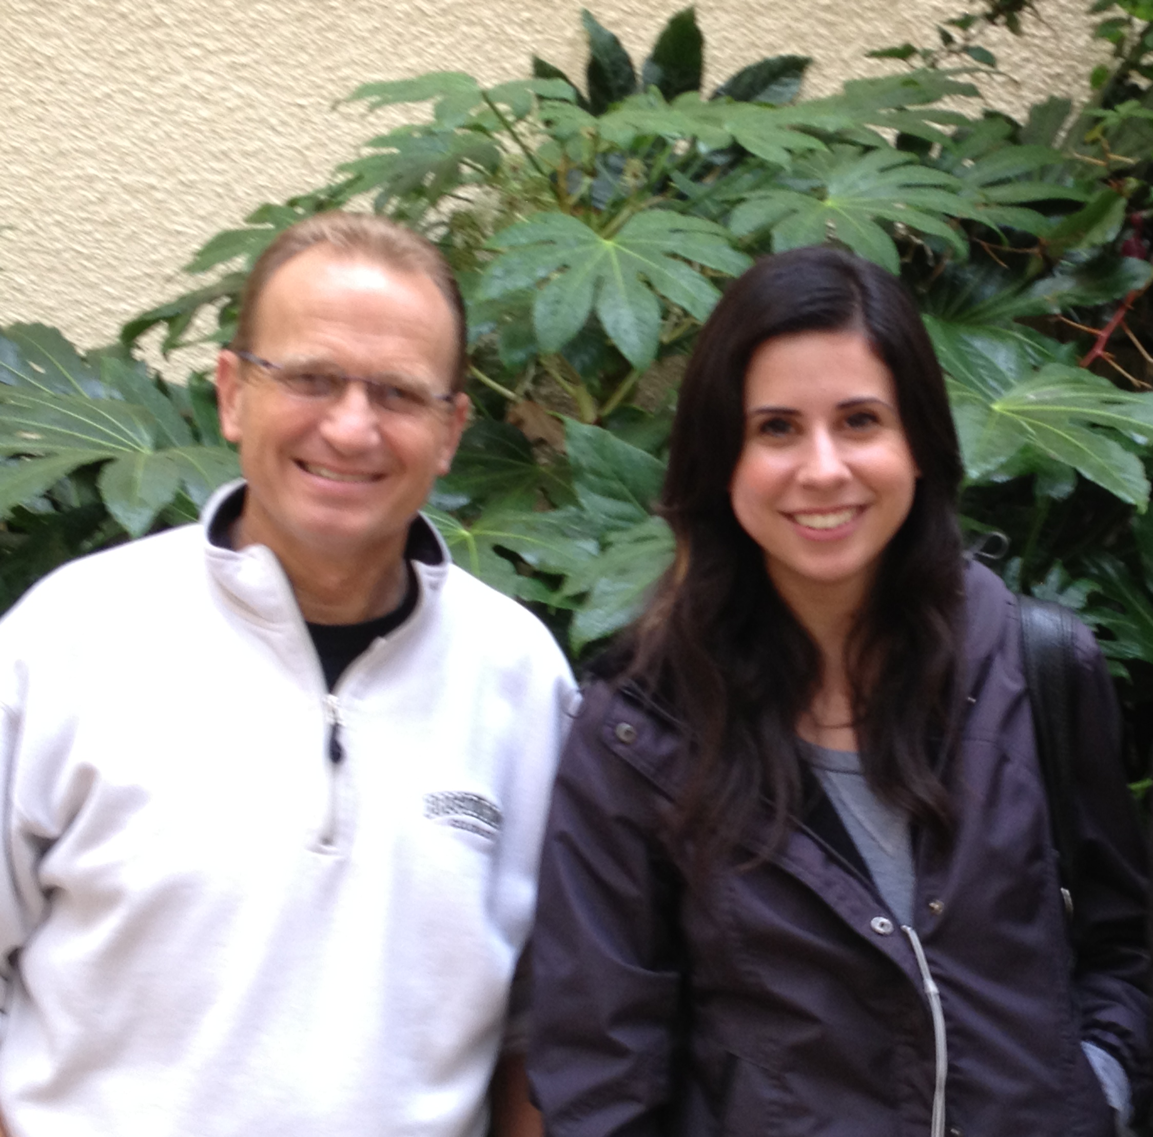
College Student Identity and Emotional Intelligence
Eugenia V. Purcar
Dr. Don Thompson, Dr. Cindy Miller-Perrin Division of Natural Science; Pepperdine University
::Results::
Abstract
This research examines the longitudinal relationship between identity and emotional intelligence development in undergraduate students. Using sample data collected from approximately 4000 undergraduate subjects who completed a 400 item survey during each of four college years, we examine the relationship between the Objective Measure of Ego Identity Status (OMEIS) and a number of Emotional Intelligence indicators, measured longitudinally.
.825 Significance
.’054 Significance
Methods
From 2010 to 2012, 3,824 responses were obtained to the OMEIS survey. Because we were primarily interested in longitudinal trends, we specified the data set to include only students who had taken the survey both their freshman and junior years. Thus the data is divided into two sets, freshman, or, “2010” and juniors, “2012.” This yielded a sample size of 112.
.769 Significance
.535 Significance
Introduction
The OMEIS is an instrument used to measure ego identity in an attempt to offer an alternative to a clinical overview. It assigns scores to four identity status scales: diffusion, foreclosure, moratorium, and achievement. The four status values are driven by two binary variables: exploration and commitment. Diffusion as one’s status describes one who has not explored nor made a commitment on his or her beliefs, values, roles, ideological alliances. Foreclosure is the next status, and refers to those have committed to various ideological beliefs but have not explored those beyond their own. The moratorium status applies to individuals who are in the midst of exploring, but have not yet formed their combination of ideologies, values, etc. Achievement deals with those who have investigated belief alternatives and have adopted their own as a result.
The three categories that comprise emotional intelligence are: the appraisal and expression of emotion, the regulation of emotion, and the utilization of emotions in problem solving. These three categories refer to both the individual's strength in applying them to the self as well directing them towards others and can be both verbal and non-verbal.
References
Adams, Gerald R.The Objective Measure of Ego Identity Status: A Reference
Manual. 1998.
N. S. Schute et al. Development and Validation of a Measure of Emotional
Intelligence, 1997. Personality and Individual Differences. 1998:
167-177.
Miller-Perrin, Thompson. The Development of Vocational Calling, Identity, and
Faith in College Students: A Preliminary Study of the Impact of Study Abroad. 2012; 13
.98 Significance
.967 Significance
.535 Significance
Discussion
Across the identity measures, there exist some noteworthy patterns. The data indicates that diffusion is higher in males than females and actually increases in both genders over time. In the results given by the foreclosure graph, there was a higher mean score for females which then decreased junior year, while the male mean score exhibited a reverse trend. In contrast, the moratorium measure revealed the exact opposite: male scores were higher freshman year, then decreased junior year with the female mean score exceeding the male score freshman year. The achievement score exhibited the same trend as diffusion, with male scores being consistently higher for each year.
For appraisal and expression, regulation, and utilization the male score was consistently higher across all three measures for every year. While the first two categories’ charts indicate that the mean decreased between age group, at statistically significant levels, utilization surprisingly increased. This pattern is observed regardless of gender. (need a “conclusion” box, indicating what conclusions we are to draw from all of this. This might be a place to insert some correlation or regression results.)
Acknowledgments
Thank you to the Pepperdine Natural Science Department and Dr. Thompson for their support throughout this project.

